Slide 1
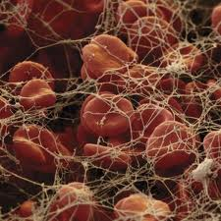
Hematology & Anesthesia
University of Maryland
Nurse Anesthesia Specialty

Slide 2
Objectives
Review physiology involved in:
Primary hemostasis
Secondary hemostasis
Fibrinolysis
Review action of anticoagulants, aspirin, NSAIDs & anti-fibrinolytics
Apply anesthesia principles in the care of patients with coagulation disorders & alterations in hemoglobin

Slide 3
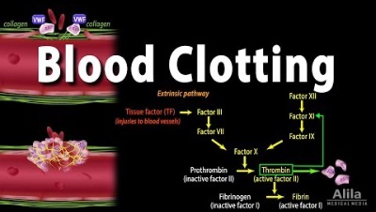
Notes:
Extrinsic vs. Intrinsic Pathway

Slide 4
Stages of Hemostasis
Primary
Platelet & wall mediated, within seconds, formation of plug, prevents blood loss (smaller vessels)
Vasoconstriction
Platelet adhesion
Platelet aggregation
Secondary
Mediated by coag factors, takes minutes, forms stable fibrin plug, prevents blood loss (large vessels)
Activation of coagulation factors
Formation of fibrin
Fibrinolysis
Activation of fibrinolysis
Lysis of platelet plug
Notes:
Primary there is an injury and creates a plug - very weak (not stable)
Vasoconstrict
Secondary - forms stable
fibrin makes it stable
Fibrinolysis
breaking down of clot

Slide 5
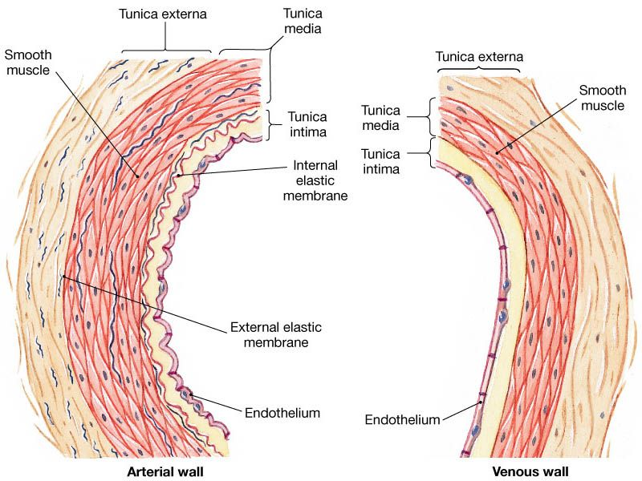
The Normal Vessel Wall
Blood vessels are cylindrical and consist of 3 distinct layers
The intima
The media
The adventitia
Notes:
Normal Vessel Wall - intima, media, adventitia
Venous and arterial will both constrict - but arterial will constrict better

Slide 6
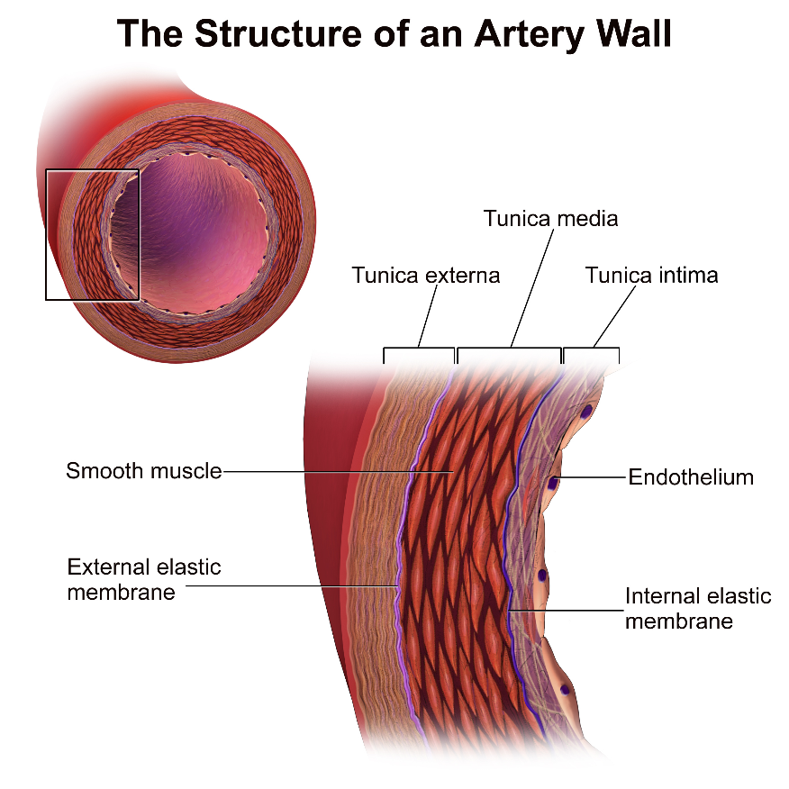
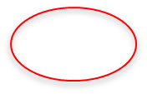
The Intima
The intima
The inner layer, separating the flowing of blood from the vessel
Forms a barrier separating the fluid contents within the blood vessel (red blood cells, white blood cells, albumin, globulins, fibrinogen, and platelets) from the thrombogenic material (collagen and procoagulants) found in the middle layer, within the subendothelial space
The smooth endothelial lining physically repels the blood components away from the vessel wall, preventing activation of the clotting mechanisms
Primarily made of endothelial cells
Endothelial secretes:
vWF- procoagulant
Tissue Factor- procoagulant
Prostacyclin- vasodilate
Nitric oxide vasodilate
Notes:
Intima - inner layer
Forms a barrier separating the fluid contents THROMBOGENIC MATERIAL (collagen and procoagulants)
Primarikly made of endothelial cells
Endothelial Secretes:
vWF - procoagulant
Tissue Factor - procoagulant
Prostacyclinc - vasodilate
Nitric Oxide - vasodilate

Slide 7
Procoagulants, Anticoagulants, & Fibrinolytic Activities
Property | Mediator | Function
Procoagulant | Coagulation factors Collagen vWF Fibronectin Thrombomodulin | Coagulation Tensile strength Adhesion Mediates cell adhesion Regulate anticoagulant pathway
Anticoagulant | Antithrombin III Tissue pathway factor inhibitor Protein C Protein S | Degrades factors XII, XI, X, IX, & II Inhibits tissue factor Degrades V &VII Cofactor for protein C
Vasodilation | Nitric oxide Prostacyclin | Vasodilates Vasodilates, inhibits aggregation Both promote smooth-muscle relaxation
Vasoconstriction | Thromboxane A2 ADP (adenosine diphosphate) Serotonin | Vasoconstriction Vasoconstriction Vasoconstriction
Fibrinolytic | Plasminogen tPA Urokinase | Converts to plasmin Activates plasmin Activates plasmin
Antifibrinolytic | Plasminogen activator inhibitor A-Antiplasmin | Inactivates tPA, urokinase Inhibits plasmin
Notes:
Know this
SSRIs
Plasminogen - TPA -
Anticoagulant - degrades factors XII, XI, X, IX amd II

Slide 8
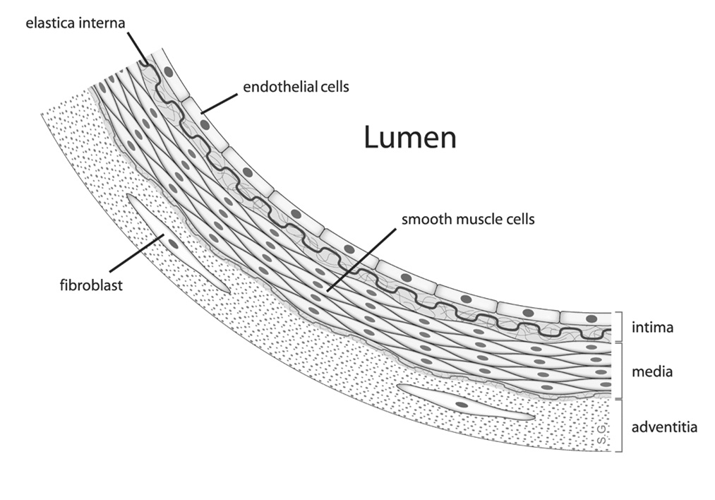
The Endothelial Cell

Slide 9

The Media or Sub endothelial
The second layer of the vessel wall (sub endothelial layer)
Extremely thrombogenic and active
Contains:
Collagen: a potent and important stimulus for platelet attachment to the injured vessel wall
Fibronectin: which facilitates the anchoring of fibrin during the formation of a hemostatic plug

Slide 10
The Adventitia
Participates in the control of blood flow by influencing the vessel’s degree of contraction
The endothelial cells produce nitric oxide (NO) and prostacyclin, which influences the adventitia
NO affects platelet function by inhibiting platelet adhesion, aggregation, and the binding of fibrinogen between glycoprotein IIb/IIIa complex
The ability of NO to influence and promote smooth muscle relaxation = vasodilation
http://oubremedical.com/nitric-oxide/

Slide 11
Function of NO
NO found in blood vessels and macrophages
Once the vessels dilate, the increase in blood flow limits the activity of procoagulant mediators by simply washing the procoagulant mediators away
This metabolic reaction occurs within the endothelial lining
Under the influence of nitric oxide synthase (NOS), L-arginine is converted to NO, which then diffuses into the muscle cells and activates soluble guanylate cyclase= cyclic guanosine monophosphate= causing muscle relaxation

Slide 12
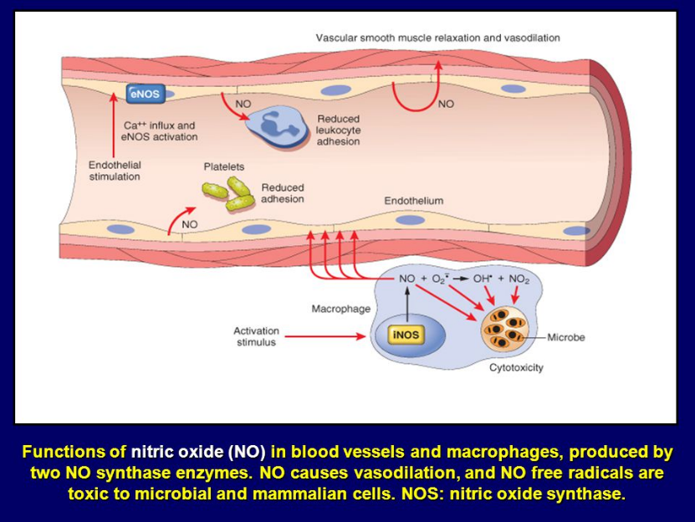
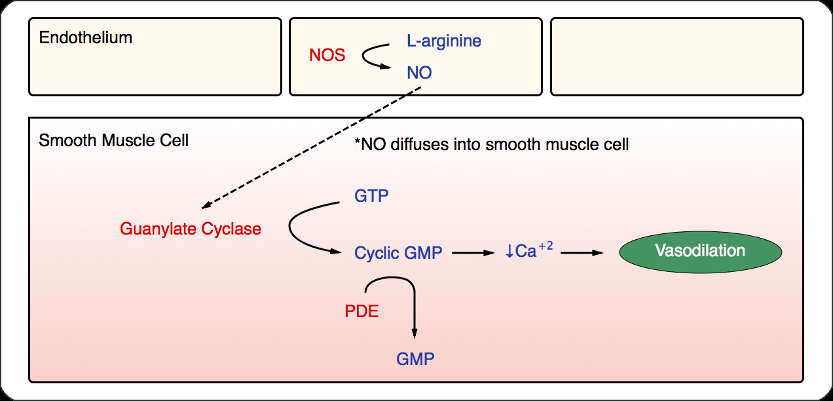
Nitric Oxide cGMP Pathway

Slide 13
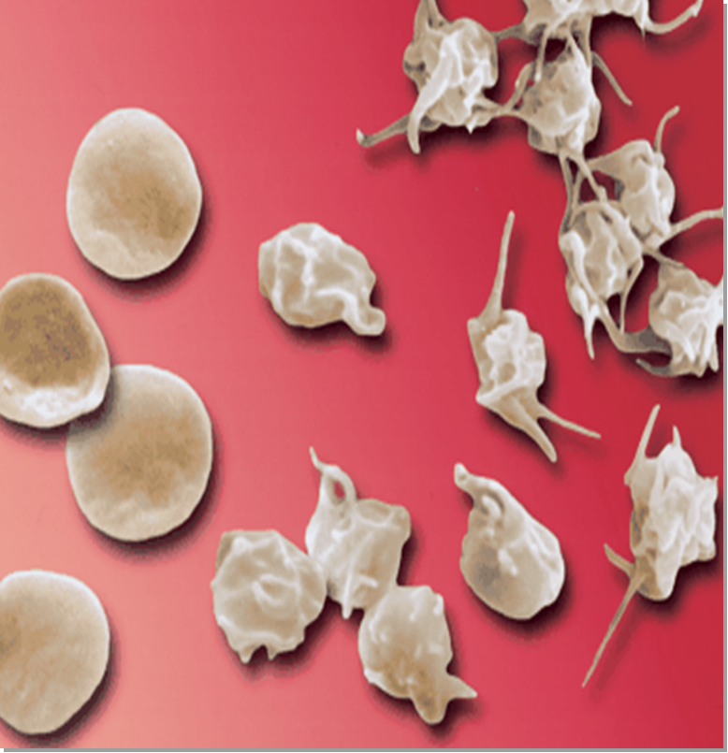
Platelets (thrombocytes)
Oval rounds discs
1-4 micrometer diameter
Formed in bone marrow
from megakaryocytes
Normal level
150K-300K per microliter
No nuclei
Cannot reproduce
Life span is 8-12 days
(need to produce 15-45K/day)
Notes:
ALSO KNOW BOLD BLACK

Slide 14
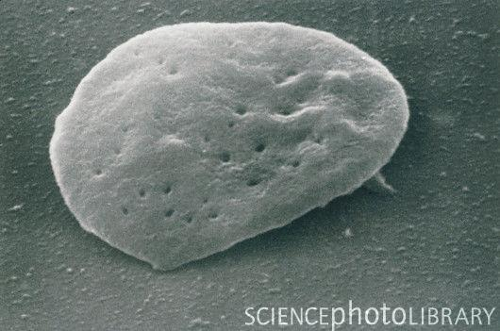
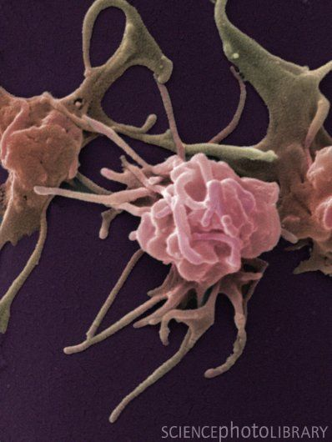
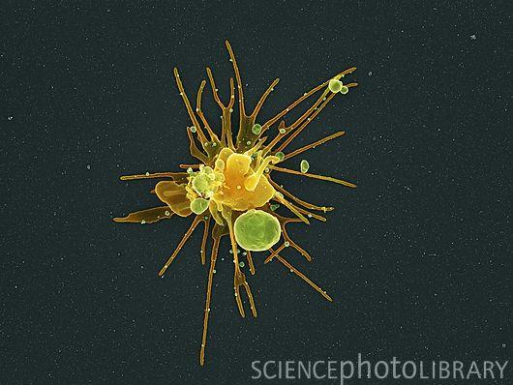
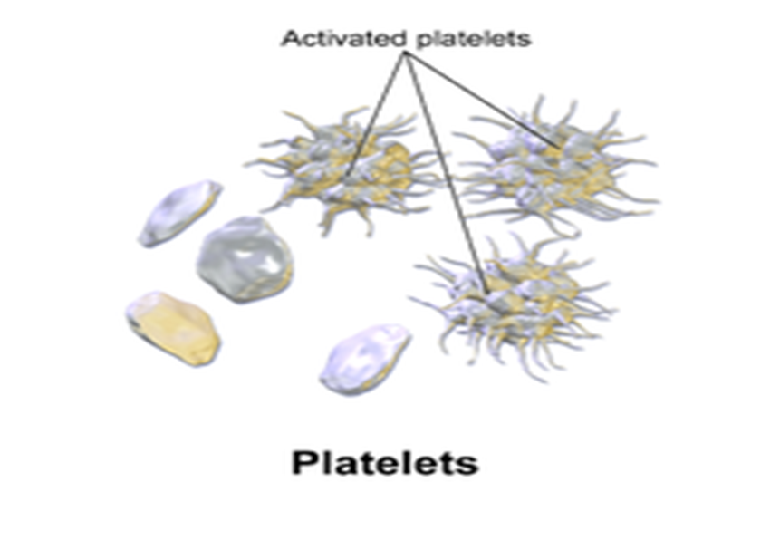

Slide 15
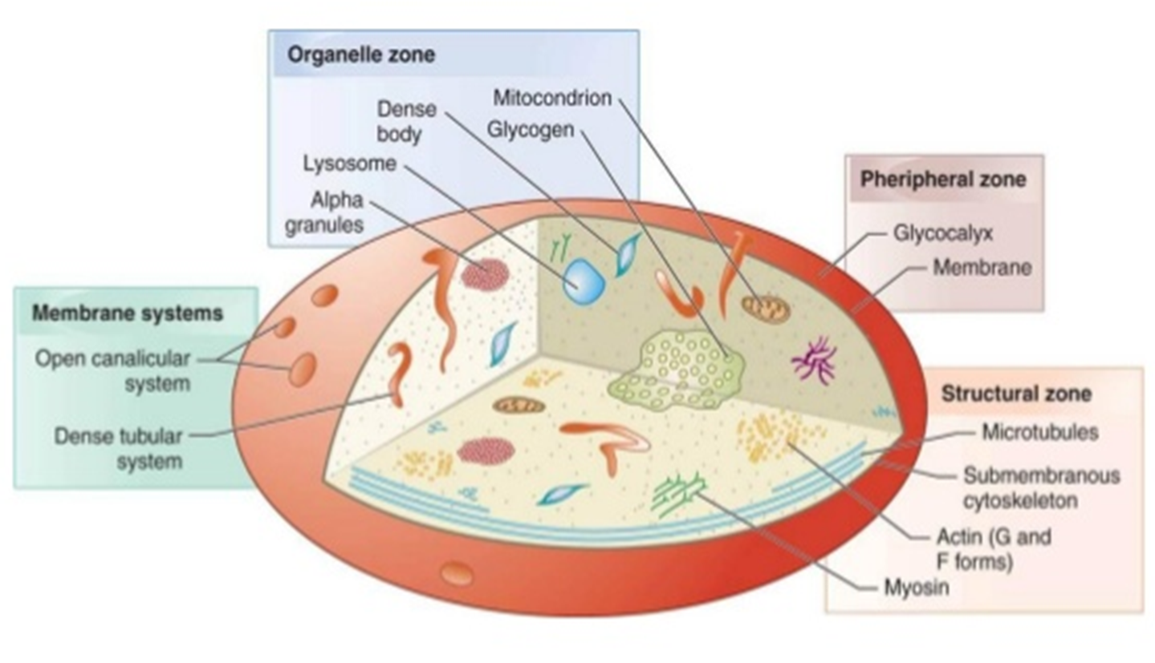
Structure of Platelets

Slide 16
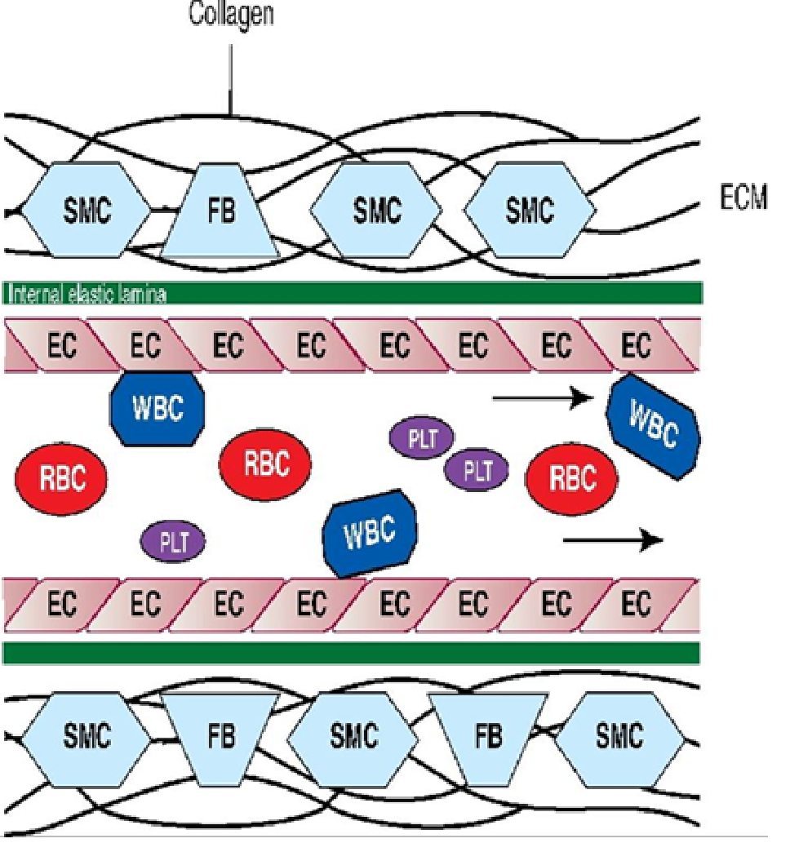
Normal Blood Flow in Intact Vessels

Slide 17
Primary Hemostasis

Slide 18
Initiation of Coagulation
Trauma causes vessel to contract
↓’s blood flow to affected area
constriction
local myogenic spasm→ platelet activation → local humoral factors→ d/t pain
Thromboxane A2 and ADP released from platelets
The area adjacent to the injury vasodilates and distributes blood to the surrounding organs and tissues
Greater trauma = greater spasm
Contraction is followed by: adhesion, activation, and aggregation to form a primary plug
Notes:
Thromboxane A2 and ADP released from platelets

Slide 19
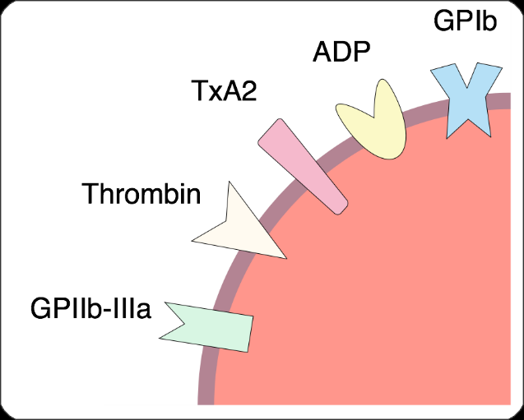
Adhesion Stage
vWF mobilizes from within the endothelial cells and emerges from the endothelial lining
Glycoprotein Ib (GpIb) receptors emerge from the surface of the platelet
GpIb attaches to vWF and attracts platelets to the endothelial lining
vWF makes platelets sticky and allows them to adhere to the site of injury

Slide 20
Adhesion
Under the influence of Tissue factor or thromboplastin, the platelet then undergoes a conformational transformation as it becomes activated
Disk-like structures swells and become oval and irregular
From the platelet surface two other major glycoproteins, IIb, and IIIa, project themselves outward
The purpose of the GpIIb-IIIa receptor complex is to link other activated platelets together in an effort to form a primary platelet plug
Platelets also release alpha and dense granules, contractile granules, thrombin and many important mediators into the blood in an effort to promote procoagulant activity= forming a primary unstable clot
Notes:
Adhesion under the influence of TIssue Factor or Thromboplastin there is a change in the shape and becomes activated
Glycoproteins IIb and IIIa

Slide 21
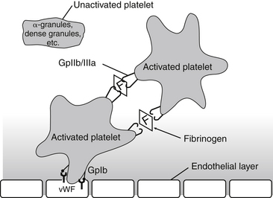
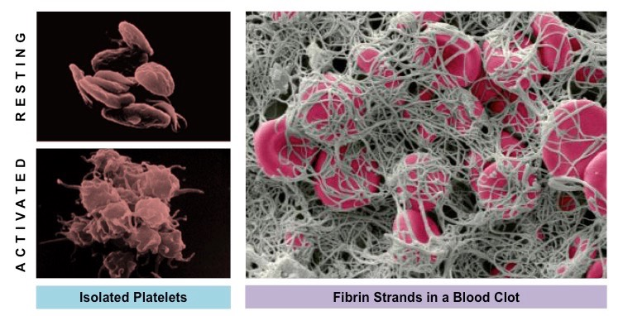
Platelet Adhesion and Aggregation

Slide 22
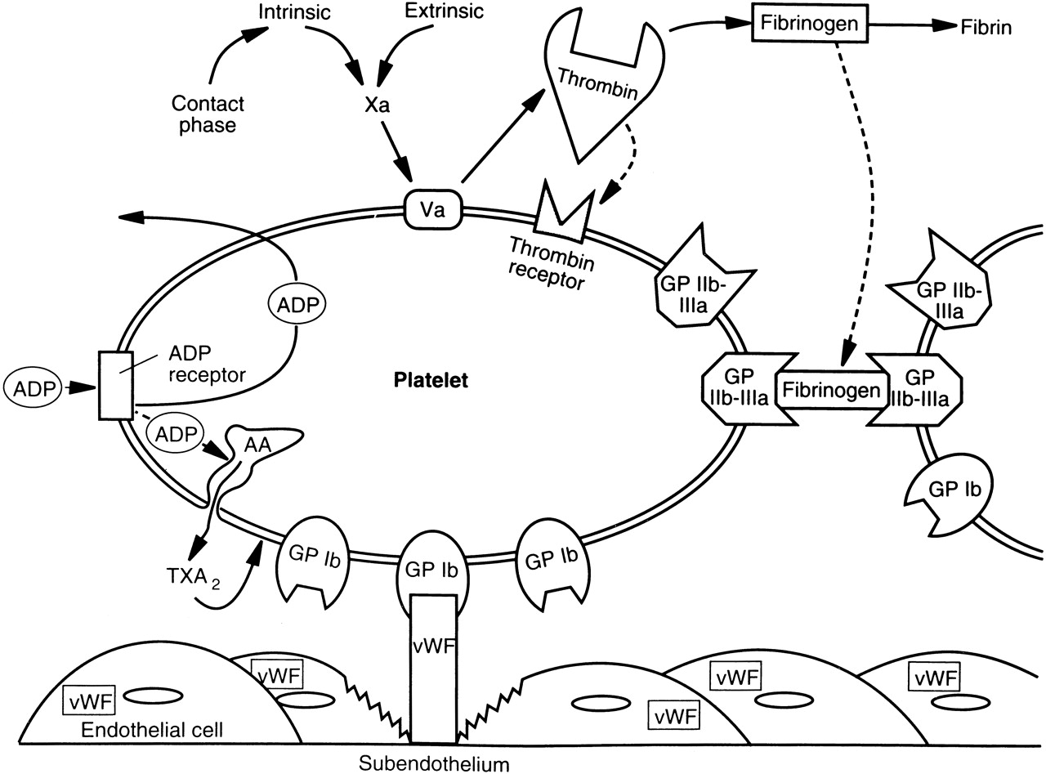
Adhesion
OUCH !
INITIAL INJURY
Notes:
vWF connects to GP Ib on the platelet

Slide 23

Primary Hemostasis
HELP !
CELLULAR RESPONSE
Thrombin combines with its receptor on the platelet surface
Platelet undergoes shape change
Thromboxane (TXA2) & ADP are released from platelet
Notes:
Thrombin combines with its receptor on the platelet
Thromboxane TXA2 and ADP are released from platelet

Slide 24
Primary Hemostasis
Platelet Aggregation
Platelet is now activated:
Contracts and releases fibrinogen
Fibrinogen attaches to its receptor
Platelets are linked together
Water-soluble & friable clot is formed
Notes:
Fibrinogen attaches to its receptor

Slide 25

Calling in the troops!
Aggregation
Notes:
Firinogen and GP IIB - IIIa links togehter

Slide 26
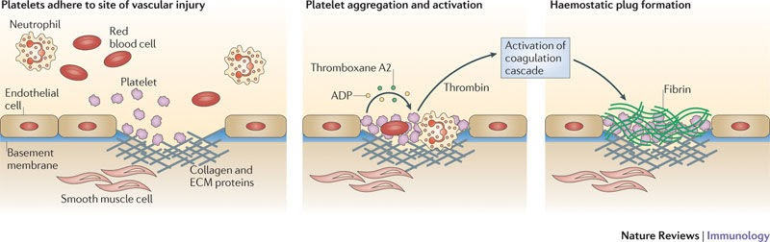
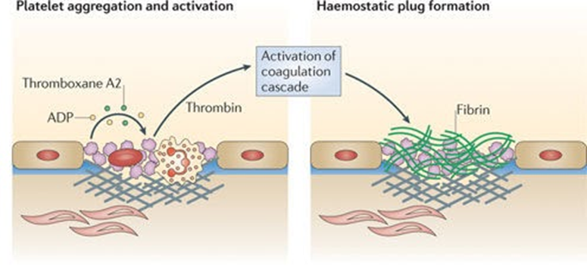

Slide 27
Let’s Review
Mechanism of platelet plug formation
Damage to vascular surface
Swell and becomes irregularly shaped
Release granules that contain multiple active factors
Becomes sticky/adhere to collagen and vWf
Secrete large amounts of ADP/thromboxane A2
Leads to aggregation/activation of other platelet
This process continues until a platelet plug is formed
If hole is small platelet plug will suffice
https://www.youtube.com/watch?v=QQHjIYPCRUQ
Notes:
Fibrinogen becomes sticky/adhere to collagen and vWf
What causes the conformational shape
Thromboxane A2
Nitric Oxide does not occur in this part

Slide 28
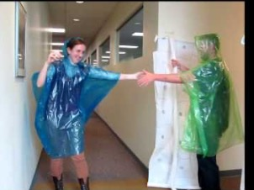

Slide 29
Coagulation Cascade
When the injury is large, activation of coagulation clotting cascade is required for permanent repair to create and stabilize a secondary clot to cease bleeding
Coagulation cascade illustrates the activation of cofactors (also referred to as zymogens) and their role in hemostasis:
The coagulation factors circulate as inactive (procoagulants) cofactors until they are activated to assist in the process of coagulation
END GOAL: Production of FIBRIN required by ALL of the clotting factors!
Notes:
Calcium is not made by the body - come from the diet
End goal: production of fibrin

Slide 30
Procoagulants
Factor | Factor Name | Synthesized | Vitamin K Dependent | Action
I | Fibrinogen | Liver | No | Forms a clot
II | Prothrombin | Liver | Yes | When in active form, activates I, V, VII, XIII, platelets, and protein C
III | Tissue factor or thromboplastin | Vascular wall and extravascular cell membrane; released from traumatized cells | No | Cofactor of VII
IV | Calcium | Diet | No | Promotes clotting reactions
V | Proaccelerin | Liver | No | Cofactor of X; forms a prothrominase complex
VI | Unassigned | N/A | N/A | N/A
VII | Proconvertin | Liver | Yes | Activates IX and X
VIII | Antihemophiliac | Liver | No | Cofactor to IX
vWF | Von Willebrand | Endothelial cells | No | Mediates adhesion
IX | Christmas | Liver | Yes | Activates X
X | Stuart-Prower | Liver | Yes | Activates II, forms a prothrominase complex with V
XI | Plasma thromboplastin antecedent | Liver | No | Activates IX
XII | Hageman | Liver | No | Activates XI
XIII | Fibrin stabilizing | Liver | No | Cross-links fibrin
Notes:
III, IV, or vWF does not come from liver
Vitamin K dependent 2, 7, 9, 10
Know the actions

Slide 31
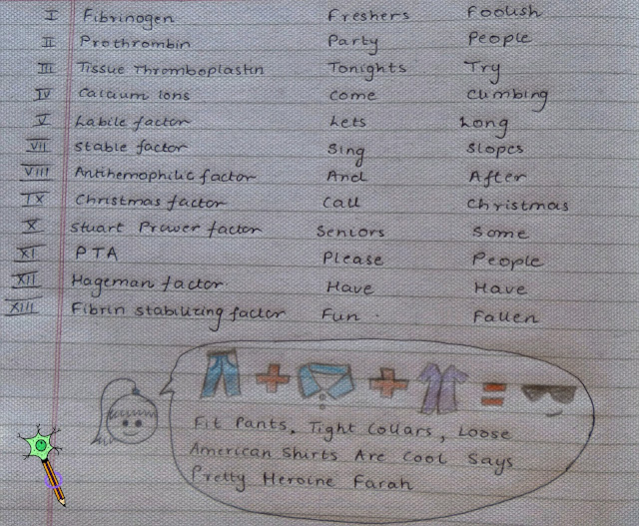

Slide 32
Anticoagulant Factors
Factor name | Synthesized | Vitamin K Dependent
Protein C | Liver | Yes
Protein S | Liver | Yes
Notes:
Know this
Anticoagulant factors deficiency will have problem with clotting too much

Slide 33
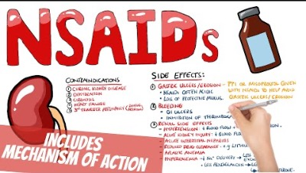
Pharmacology of Aspirin & NSAIDS

Slide 34
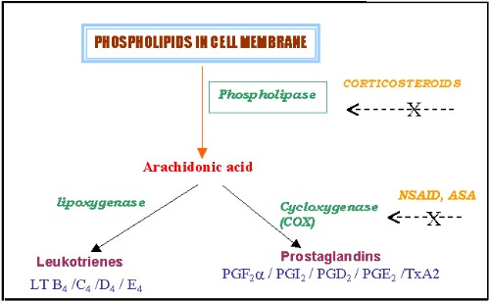
Pharmacology of Aspirin & NSAIDS
P
R
O S
S Y
T N
A T
G H
L E
A S
N I
D S
I
N
PLATELET AGGREGATION
Notes:
NSAIDs/ASA work on cycloxygenase

Slide 35
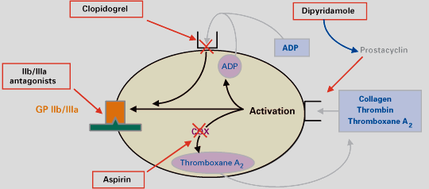
Pharmacology of Aspirin & NSAIDS
Aspirin
Acetyl group of ASA causes acetylation of cyclooxygenase
COX cannot convert arachidonic acid to thromboxane A2 (TXA2)
Platelet aggregation is impaired
The acetylation of COX persists for the life of the platelet (8-12 days)
Notes:
ASA arachidonic acid to thromboxane A2 (TXA2)
Platelet aggregation is impaired
The acetylation of COX persists for the life of the platelet (8-12 days)
What else ahs 8-12 day lifespan

Slide 36
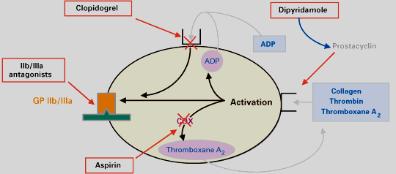
Pharmacology of Aspirin & NSAIDS
NSAIDs
Ketorolac, Ibuprofen
Produce the same effects as aspirin
Difference??
Suppression of TXA2 production by platelets is temporary
~ 24-48 hours
NSAIDs
Notes:
ASA is not temporary suppression

Slide 37
Pharmacology of Antiplatelet agents
Plavix (Clopidogrel)
Inhibits or suppresses ADP induced aggregation
Lasts lifetime of platelets
Stop 10 days prior to surgery
Dipyridamole (Persantine)
Increase cAMP in platelets
cAMP prevents aggregation
Used with coumadin inpatients with prosthetic valves
Stop 24 hours prior
GPIIb/IIIa drugs “cap” or block the fibrinogen receptor so that it cannot attach platelets therefore cannot link
Platelet aggregation is suppressed
Eptifibatide (Integrillin)
Abciximab (ReoPro)
Tirofiban (Aggrastat)
Notes:
PLAVIX is not temporary
Stop 10 days prior to surgery
Lasts lifetime of platelets
Inhibits or suppresses ADP induced aggregation
GPIIb/IIIa drugs “cap” or block the fibrinogen receptor so that it cannot attach platelets therefore cannot link
Platelet aggregation is suppressed

Slide 38
Secondary Hemostasis

Slide 39
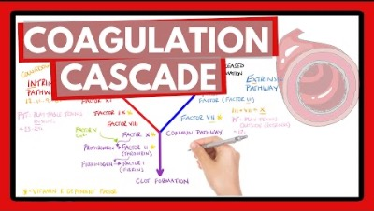

Slide 40
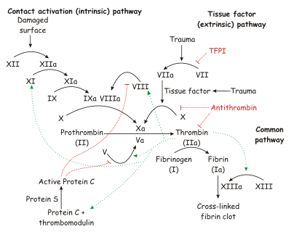
Secondary Hemostasis (formation of a stable clot)
III
.37
12⭢11.98
Notes:
Intrinsic 12 → 11 → 9 → 8
Extrinisc
3 → 7
Firbin 1a
Common pathway - fibrin
Protein C and Protein S will create bleeding issues????
Common pathway starts at 10 - you need factor 2 to create thrombin (IIa)

Slide 41
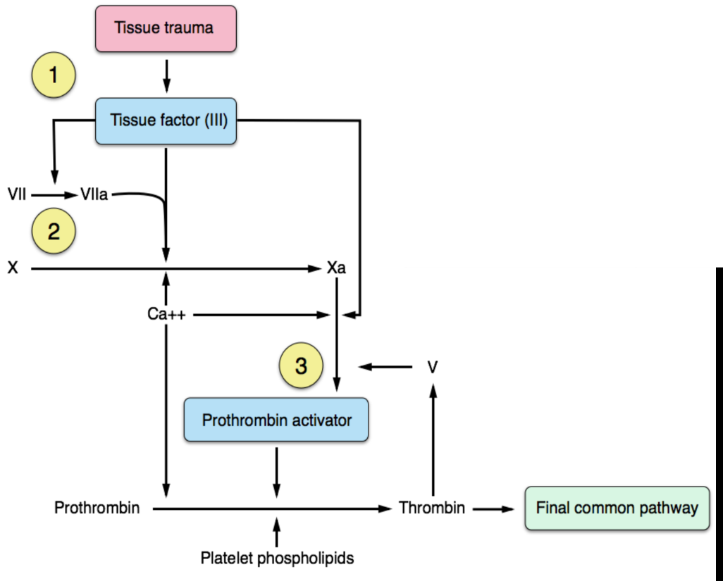
Extrinsic Pathway

Slide 42
Extrinsic Pathway
Becomes activated by the release of tissue factor when injury occurs OUTSIDE the vessel wall
This section of the coagulation cascade consists of factor III and factor VII
Tissue factor activates proconvertin changing it activated factor VII (VIIa)
Once factor VII is activated (VIIa), it in turn activates factor X (Stuart-Prower) of the common pathway with the help of calcium
Factor X forms a complex with factor V, activating factor II, which when activated becomes factor IIa
Activated thrombin (IIa) in turn activates factor I (fibrinogen) to form activated factor I (Ia, fibrin)

Slide 43
Intrinsic Pathway
Contact activation pathway
Initiated when damage occurs to the blood vessels themselves
The intrinsic pathway is initiated by activation of factor XII (Hagenman)
By prekallikrein & high molecular weight kininogen
Notes:
Intrinsic Pathway - Initiated when damage occurs to the blood vessels themselves (inside)
Factor 12

Slide 44
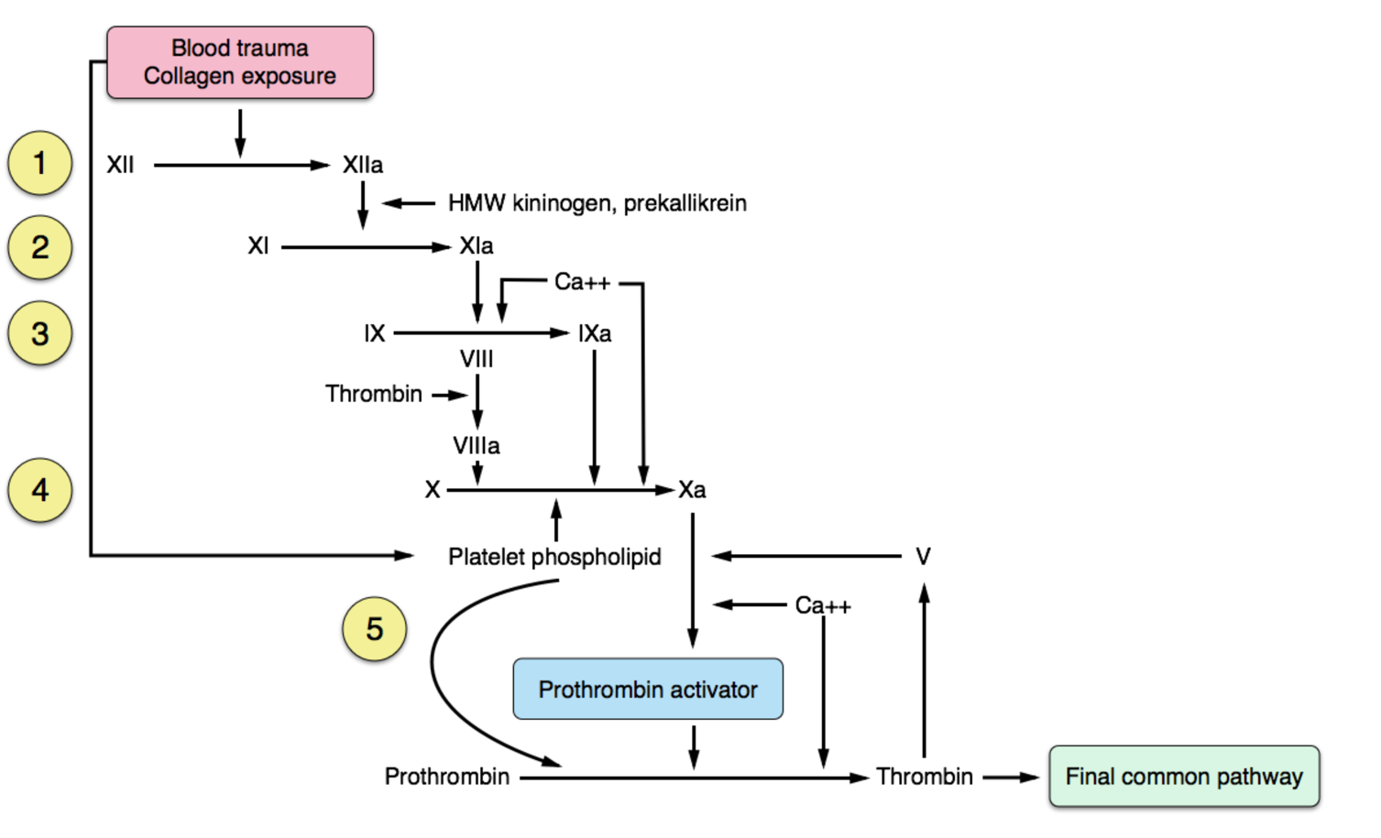
Intrinsic Pathway

Slide 45
Intrinsic Pathway
Factor XII activates factor XI
Then activates IX (Christmas)
Then activates factor X
The result is the generation of fibrin from activation of prothrombin to thrombin
Conversion of prothrombin to thrombin is an important reaction for both coagulation pathways
Thrombin assists in activating factors V, VIII, I, and XIII and influences the recruitment of platelets to the injured area

Slide 46
Thrombin
Thrombin also behaves as an anticoagulant
It prevents clot formation by releasing tissue plasminogen activator (tPA) from endothelial cells
Stimulates protein C & S to inhibit clot formation
Forms a relationship with antithrombin III to interfere with coagulation
Thrombin assists in activating factors V, VIII, I, and XIII and influences the recruitment of platelets to the injured area

Slide 47
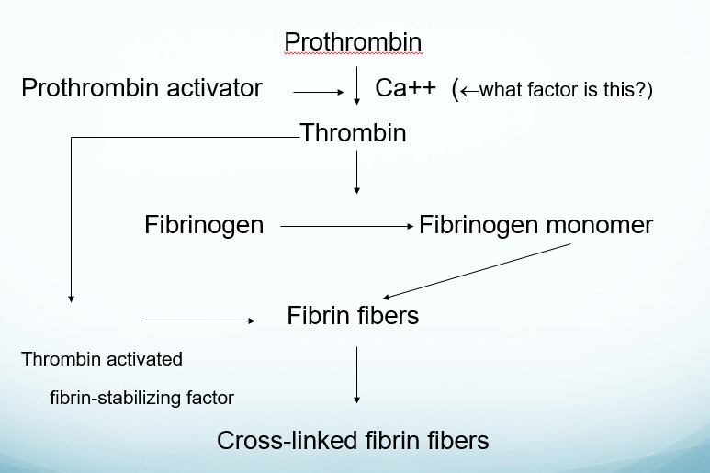
Common Pathway
Notes:
Calcium is factor 4

Slide 48
Common Pathway
Factor X has been activated by the intrinsic and extrinsic pathways
Factor X requires the help of factor V (proaccelerin) and calcium to convert factor II (prothrombin) to its active state, thrombin (IIa)
Thrombin then activates factor I (fibrinogen) to its active form Ia (fibrin)
Factor XIII (fibrin stabilizing factor) is required to ensure the platelet plug will hold (helps to form a cross link mesh within the platelet plug)
Fibrin (Ia) inconjuction with factor XIII finally secures a stable secondary plug and bleeding stops
Notes:
1, 2, 5, 10 are all in common pathway
Factor 13 (fibrin stabilizing factor) is required to ensure the platelet plug will hold

Slide 49
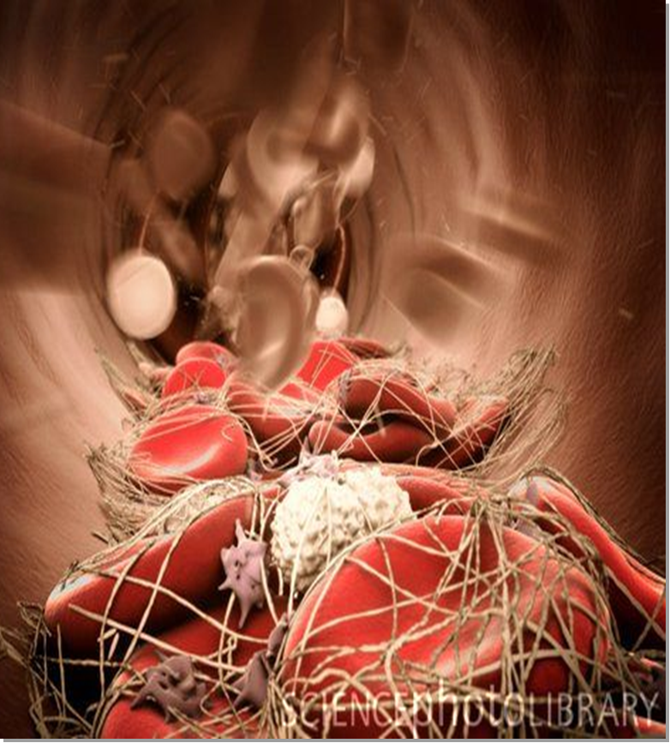
End Goal

Slide 50
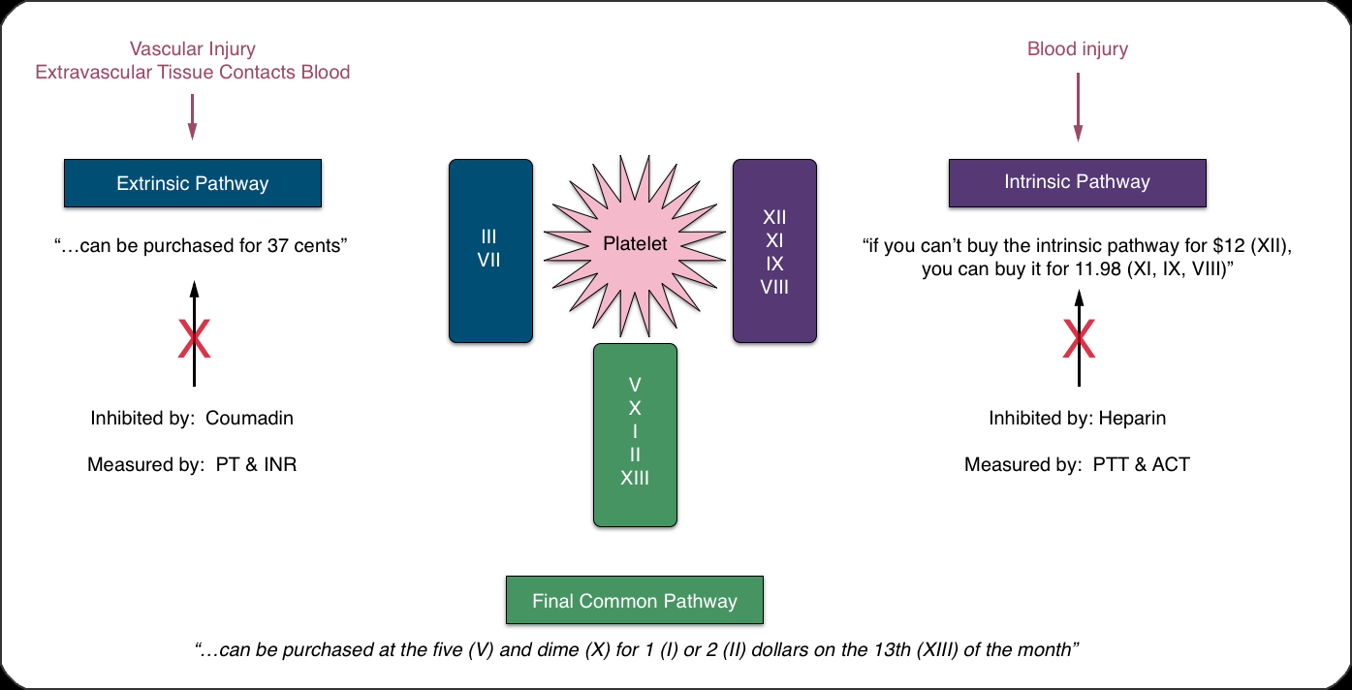
Summary
Notes:
Intrinsic is inhibited by Heparin and measured by PTT and ACT
Extrinsic is inhibited by Coumadin and measured by PT and INR

Slide 51
Warfarin
Inhibits the enzyme vitamin K epoxide reductase complex 1, which is responsible for converting inactive vitamin k to active vitamin k
Vitamin K in competitively inhibited
Indirectly block the manufacturing of the vitamin K dependent factors (II, VII, IX, X, Protein C and S)
Monitored with PT/INR. Therapeutic concentration is 2-3 times normal
Vitamin K (10-20 mg) and FFP (1-2 units) are antidotes
Notes:
Warfarin - inhibited by Vitamin K
Vitamin K (10-20 mg) and FFP (1-2 units)

Slide 52
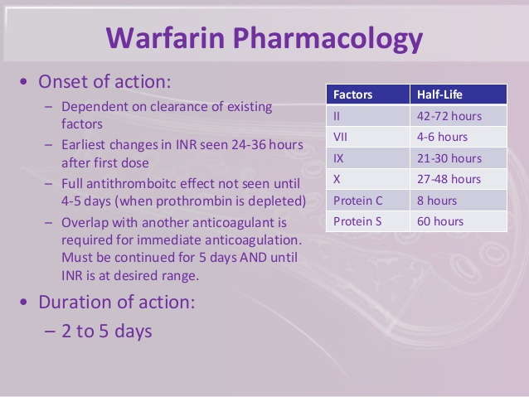

Slide 53
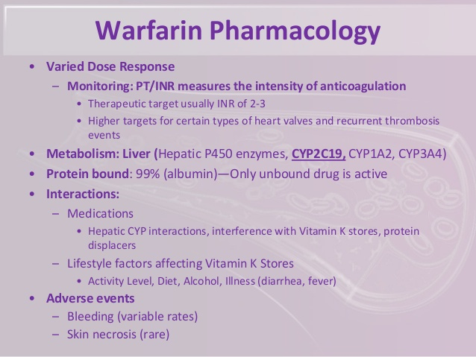

Slide 54
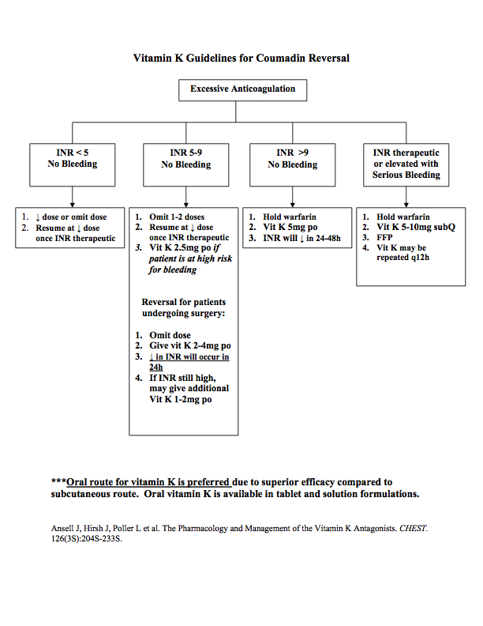

Slide 55
Heparin
Inhibits the intrinsic and final common pathways
Antithrombin III is a naturally occurring anticoagulant that circulates the plasma
Heparin binds to antithrombin and accelerates its ability 1000 times
The heparin antithrombin complex neutralizes thrombin (IIa) and activated factors IX, X, XI, & XII
Also inhibits platelet function
Monitored via aPTT (normal is 25-35 seconds)
Monitored by ACT (90-120 seconds)
Notes:
Inhibits the intrinsic and final common pathways
Heparin binds to antithrombin and accelerates its ability 1000 times
Heparin is monitored viat PTT and ACT

Slide 56
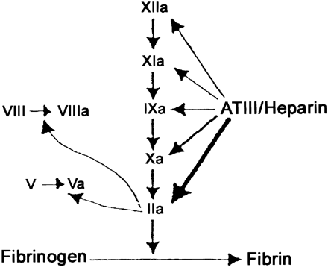
Heparin
Antithrombin III:
Most important inhibitor of blood coagulation
Strongly inhibits final pathway factors:
IIa (thrombin)
X
Partially inhibits intrinsic pathway factors:
XIIa
XIa
IXa
AT3 is a required cofactor for heparin

Slide 57
Cell-Based Theory of Coagulation
Newer concept for explaining the involvement of the platelet and clotting cascades in hemostasis
It hypothesizes why platelets and the extrinsic and intrinsic pathways of coagulation cascade do NOT work independently of one another but form a very interdependent relationship
The theory posits that coagulation takes places on different “cell surfaces” that bear tissue factor= leading to hemostasis
Describes hemostasis as : initiation, amplification, and propagation

Slide 58
Initiation Phase
Triggered by injury to the endothelial surface
Tissue factor is exposed at the site of injury (endothelial surface of blood vessel changes, becoming acidic and making its phospholipid surface less repellent to platelets)
Tissue factor down regulates anticoagulants that reside in the sub endothelial layer(antithrombin III, thrombomodulin).
Initiation phase starts with extrinsic pathway via tissue factor and factor VII
The TF/VIIa reaction activates factor X (common pathway)= small amount of thrombin (IIa)
Thrombin levels remain low during this phase, because TF pathway inhibitor limits the amount of TF releases
The quantity of thrombin produced during the initiation phase is not enough to activate fibrin

Slide 59
Phases
Amplification Phase
Propagation Phase
The small amount of thrombin produced in the TF cells amplifies the coagulation response
It activates platelets, factor V, and XI
The large burst of thrombin required to produce hemostasis is produced during this phase
It begins when factor X is activated by factors IV (calcium), VII, and IX on the surface platelet
It produces a positive feedback mechanism that produces enough thrombin to activate fibrin

Slide 60
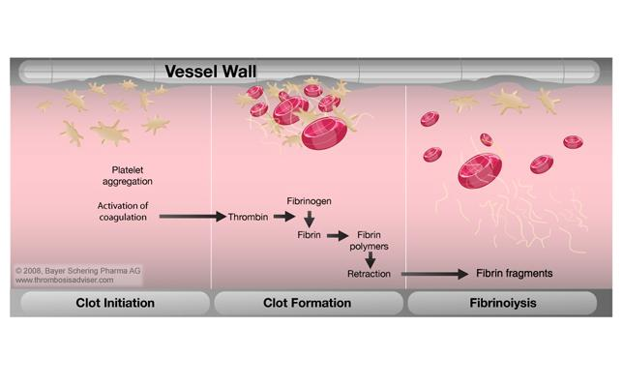
Fibrinolysis

Slide 61
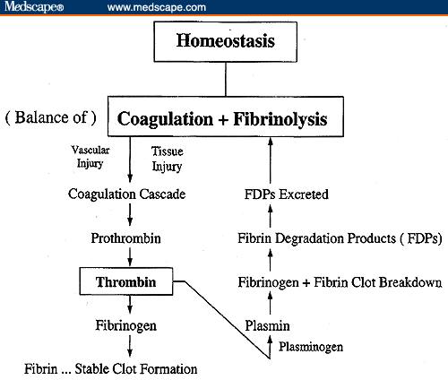
Fibrinolysis

Slide 62
The Components of Fibrinolysis
Plasminogen (inactive)
Made in the liver
Circulates in bloodstream
Incorporated into thrombus during clot formation
Plasmin (active)
Activated form of plasminogen
An enzyme
Tissue plasminogen activator (tPA)
Produced by endothelial cell
Release is stimulated by clot formation (thrombin)
Binds avidly to fibrin in clot
Urokinase plasminogen activator (uPA)
Limited amounts in blood (produced in kidneys)
Most widely used thrombolytic agent
Used in peripheral arteries and grafts
Streptokinase
Non-physiologic
Produced by beta streptococci
Little affinity for fibrin
Notes:
Plasminogen - inactive
Plasmin - active
tPA - produced by endothelial cells, release is stimulated by Clot formation
Also know uPA and streptokinase

Slide 63
Fibrinolysis
Clot is formed
Plasminogen is incorporated into clot
(think of this as an internal ‘kill switch’, it’s embedded, lurking….waiting…)
Plasmin (activated) → digests fibrin, fibrinogen, prothrombin, Factors Va, VIIIa and XIIa
Plasmin breaks down fibrin into fibrin degradation products (the ‘cleaner’)
Notes:
Plasminogen is incorporated into clot
Plasmin digests 5, 8, and 12

Slide 64
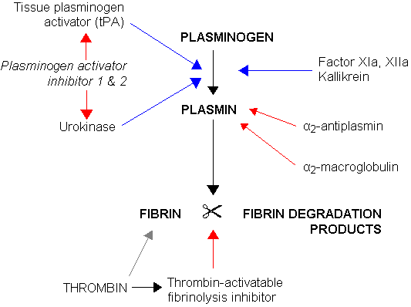
Fibrinolysis

Slide 65
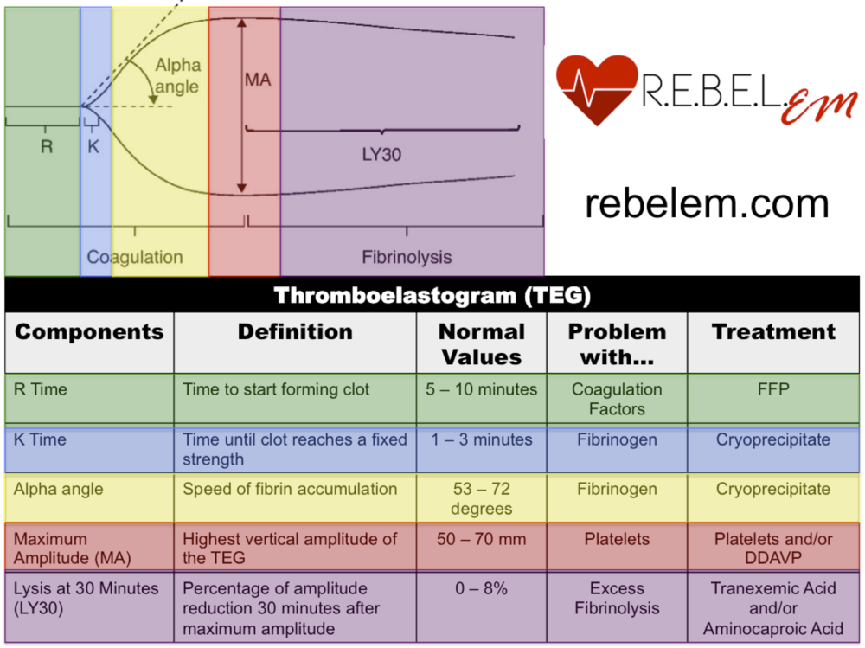
Thromboelastogram (TEG)
R: reaction time, the interval to initial clot formation. R requires thrombin (IIa) formation and prolongation is usually indicative of intrinsic pathway factor deficiency
K: the clot formation time. K is prolonged in deficiencies of thrombin formation or generation of fibrin to fibrinogen
Alpha angle: measures speed of clot formation. The alpha angle is similar to K and is affected by the same factors that prolong K
MA: measure of absolute strength of a fully formed clot. MA reflects primarily platelet number and function.
LY30: is used as a measure of fibrinolysis
Notes:
R - time - time for the clot to start forming (5-10 minutes) - FFP
k - time - time will clot reaches a fixed strength - cryo
Alpha angle - speed of fibrin accumulation
MA - Highest vertical amplitude of the TEG
Lysis at 30 minutes
Know the picture

Slide 66
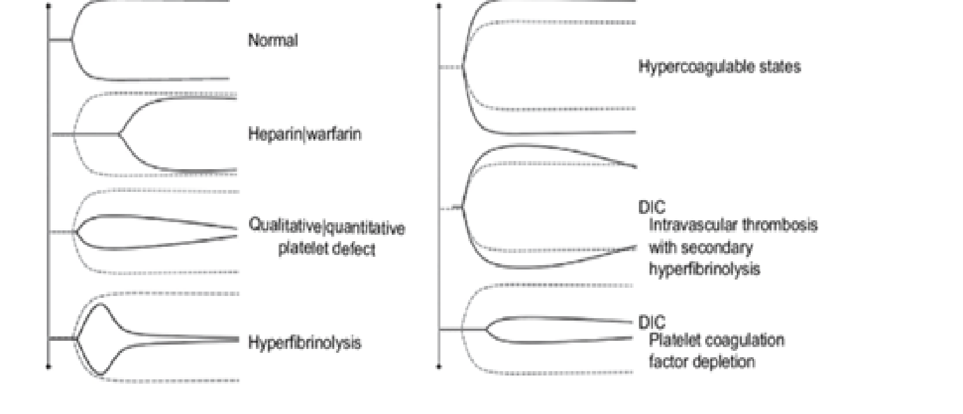
TEG
Notes:
One of these will be on the exam - know the pictures

Slide 67
Anticoagulant Pharmacology

Slide 68
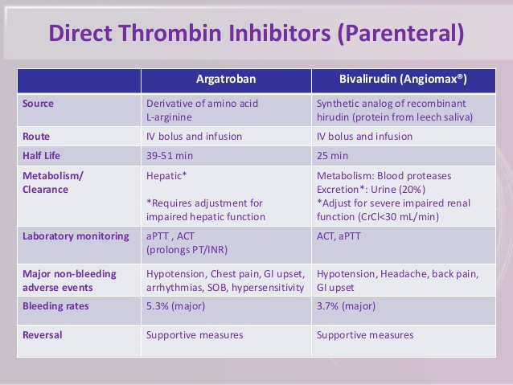
Notes:
2nd lecture of spring

Slide 69
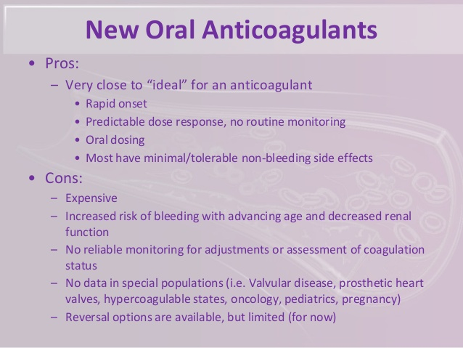

Slide 70
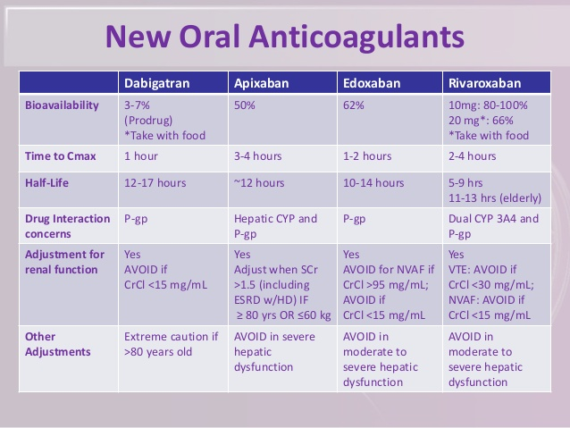
Notes:
Not tested on

Slide 71
Antifibrinolytic Pharmacology
Aprotinin:
potent plasmin inhibitor
leads to slowed fibrin breakdown
used during cardiac surgery to decrease bleeding
FIBRIN
PLASMINOGEN PLASMIN
FIBRIN SPLIT
PRODUCTS
Notes:
Aprotinin (potent plasmin inhibitor)
Leads to slowed fibrin breakdown

Slide 72
Antifibrinolytic
Amicar & Tranexamic Acid:
Inhibits activation of plasminogen to plasmin by competitive inhibition
At higher doses can directly inhibit plasmin
Amicar: loading dose is 50 mg/kg over 30 minutes followed by 25 mg/kg/hr until post op (used during open heart procedures)
TXA: 0.5-1 g (orthopedic protocol: 20mg/kg), usually 1 g before incision and 1 g after incision
TXA more potent than Amicar
Pharmacology
slowed fibrin breakdown
Used to control hemorrhage associated with increased plasminogen activation (hyperfibrinolysis)
Notes:
tXA - inhibits activation of plasminogen to plasmin by competitive inhibition
Pharmacology
slowed fibrin breakdown
Used to control hemorrhage associated with increased plasminogen activation (hyperfibrinolysis)

Slide 73
TXA
Contraindications:
History of CVA/TIA
Recent MI (within a year)
Cardiac stents
Prior DVT or PE
Renal insufficiency (serum creatinine greater than 1.2)
Active intravascular clotting
Color vision disorders
Notes:
tXA will make them clot - we don’t want them to have repeat

Slide 74
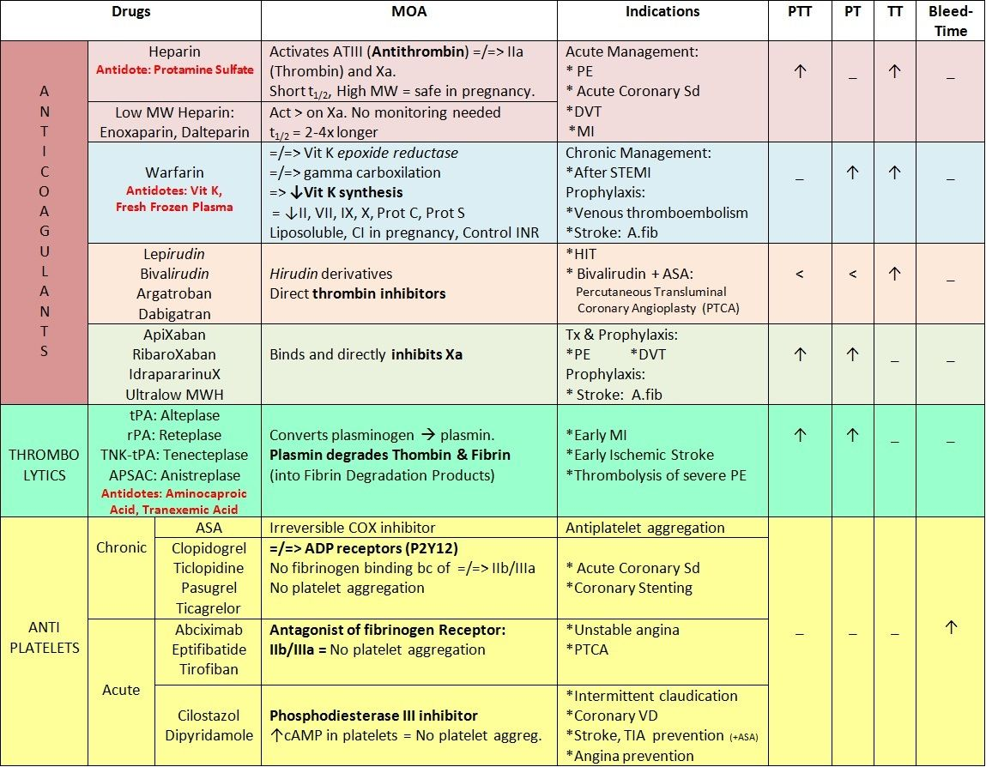
Notes:
Warfarin - FFP, Vitamin K
Thrombolytics - aminocaproic acid, TXA
Heparin - protamine sulfate

Slide 75
Coagulation Tests
Laboratory Test | Value | Description
Bleeding time | 3-7 minutes | Measures platelet function: adhesion, aggregation Not considered a routine test Modest prolongations do no predict surgical bleeding Altered by aspiring and NSAIDs
Platelet count | 150,000-350,000 mm3 | Thrombocytopenic: <100,000 mm3 Surgical risk: < 50,000 mm3 Spontaneous bleeding: <20,000 mm3
Prothrombin time (PT) | Average normal: 12-14 sec | Prolonged with: Extrinsic pathway disorder, common pathway disorder Altered by coumarin derivatives
Activated partial thromboplastin time (aPTT) (intrinsic and common pathway) | Average normal: 25-32 seconds | Prolonged with: intrinsic and common pathway disorder Altered by lovenox and heparin
Thrombin time (common pathway) | 8-12 seconds | Measures fibrinogen to fibrin reaction
Activated clotting time (ACT) | 80-150 seconds | Guides anticoagulation dosing
Fibrinogoen | > 150 mg/dL; 200-350 mg/mL | Measures fibrinogen level
Antithrombin III | 80-120% | Measures antithrombin III levels Severely depressed in DIC
Notes:
Know these
Normal platelet count 150,000-350,000

Slide 76
INR
The international normalized ratio is a calculation that standardizes PT results
Based on the ratio between the patients PT and the standard mean PT
Normal value in healthy patients is 1
Target for patients on warfarin is 2-3 times control

Slide 77
Coagulation Disorders

Slide 78
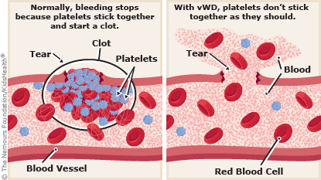
Von Willebrand’s disease

Slide 79
vWF Disease
The MOST common inherited coagulation defect
Should be suspected in any patient who has an increased bleeding time despite a normal platelet count
Abnormal binding of vWF to platelet receptors or the more common form is characterized by insufficient production of vWF by endothelial cells
Notes:
The MOST common inherited coagulation defect
Should be suspected in any patient who has an increased bleeding time despite a normal platelet count

Slide 80
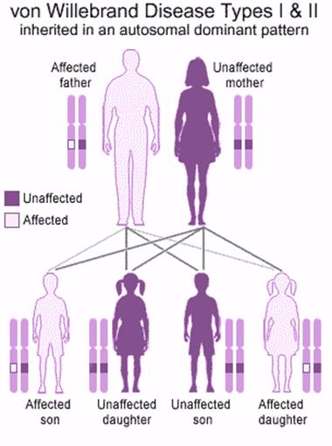
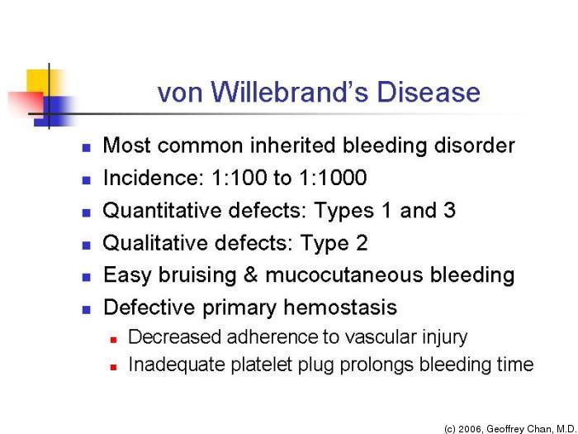


Inheritance & Incidence
of vWF disease
Notes:
easy bruising and mucocutaneous bleeding
decreased adherence to vascular injury
Don’t put NG tube
Be careful with IV placement
Be careful with positioning

Slide 81
Coagulation Disorders
Insufficient production of vWF
or abnormal attachment of VWF to the platelet receptor
Patients present with:
Normal platelet count
Normal APTT
Hx of bleeding
Poss. prolonged BT
Treatment:
DDAVP
releases endogenous vWF from the endothelial cell
FFP
Cryoprecipitate
contains factors VIII, I, XIII
Notes:
GP1b connects to vWF connects platelet to tissue
treatment: DDAVP, FFP, cryo

Slide 82
Coagulation Disorders
Hemophilia A:
#2 most common inherited coagulation disorder
Females are carriers, primarily males are affected
Factor VIII:C (antihemophiliac factor) is deficient
Treatment:
Factor VIII replacement
DDAVP
Cryoprecipitate
FFP
Notes:
#2 most common hemophilia inherited
Factor VIII:C (antihemophiliac factor) is deficient

Slide 83


Slide 84


Slide 85

Notes:
long time in hospital, trending down hemoglobin - GI bleed

Slide 86




Slide 87

Coagulation Disorders
Hemophilia B:
Least common type of hemophilia
Aka Christmas disease
Factor IX is deficient
Patients present with:
Hx of bleeding; sometimes spontaneously
Prolonged APTT
Treatment:
Factor IX replacement
FFP
Notes:
Hemophilia B Factor IX is deficient

Slide 88


Notes:
coagulopathy is bleeding and clotting

Slide 89
Disseminated Intravascular Coagulation
Characterized by disorganized clotting and fibrinolysis that leads to the simultaneous occurrence of hemorrhage and systemic thrombosis
Antithrombin and tissue factor pathway inhibitor keep the procoagulants at bay
In DIC, tissue factor is released in the absence of vascular injury
This activates the extrinsic coagulation cascade throughout the body
Clots in the microvasculature (impair tissue perfusion= tissue necrosis and end stage organ failure
Widespread fibrin deposition consumes the body's supply of fibrinogen, coagulation factors, and platelets= hemorrhage
Release of tPA and urokinase plasminogen activator occurs in DIC= INCREASED D-dimer and fibrin split products due to increased fibrinolytic activity
Notes:
clots in microvasculature
Consumes the body’s supply of fibrinogen, coagulation factors, and platelets = hemorrhage

Slide 90

DIC
3 condition associated with high risk of DIC:
Sepsis (gram negative bacilli)
OB (preeclampsia, placental abruption, and amniotic fluid embolism)
Malignancy (adenocarcinoma, leukemia, and lymphoma)
TREAT UNDERLYING DISORDER FIRST!
Notes:
Underlying disorder: sepsis, OB, malignancy

Slide 91
Heparin Induced Thrombocytopenia
Causes clot formation throughout the body
Recognized as an immunologic complication of heparin therapy
About 5% of patients who receive LMWH will develop immue reaction characteristic of HIT
HIT occurs by the formation of IgG directed against heparin platelet factor 4 immune complexes
IgG antibodies activate platelets= uncontrolled clot formation
Platelets are consumed fast = decreased platelet count

Slide 92

HIT
Notes:
Know patho for type 1 and type 2
type 2 - patient is resistant to heparin anticoagulation

Slide 93
Factor V Leiden Mutation
Causes resistance to the anticoagulant effect of protein C
Most people never develop symptoms. However, the first indication of the disorder may be the development of a blood clot (thrombosis)
Treatment is only indicated in patients with thromboembolism
Notes:
Development of blood clot

Slide 94
Hemoglobin Diseases

Slide 95


Notes:
globin has 2 alpha and 2 beta. Each subunit has one heme group

Slide 96
Types of Anemia
Hemolytic anemia- Sickle cell/G-6-PD deficiency
Iron deficiency anemia
Aplastic anemia
Megaloblastic anemia- Vit B12/folic Acid deficiency
Acute blood loss
Thalassemia
Alterations r/t Hgb binding- methemoglobinemia

Slide 97

Physiology of Anemia
Anemia
Hb concentration < 12 g/dl – women
Hb concentration < 13 g/dl - men
The most important adverse effects of anemia are decreased oxygen delivery 2/2 associated decreases in arterial oxygen content of oxygen
Compensation:
Rightward shift of oxyhemoglobin dissociation curve (to facilitate O2 release to tissues) & cardiac output
Kidney’s release erythropoietin
Anesthetic considerations for anemia
Volatile agents could blunt response to cardiac output
Volatile agents could be less soluble in anemic patients
Decreased tolerance to blood loss and hypoxemia more prevalent
Less availability of coagulation factors
Notes:
The most important adverse effects of anemia are decreased oxygen delivery 2/2 associated decreases in arterial oxygen content of oxygen
Volatile agents could be less soluble in anemic patients → more goes to the brain (read the book on this)

Slide 98
Sickle Cell Anemia

Slide 99

Notes:
Important: mutation on the beta globulin

Slide 100

Notes:
Healthy red blood cell lasts 120 days
Sickle cell lasts 10-20 days
Clots, pain, swelling, heat
Liver damage causing jaundice

Slide 101

Sickle Cell Anemia
Caused by the substitution of a valine for glutamic acid in the ß – globin subunit
In the deoxygenated state, this HbS undergoes conformational changes exposing a hydrophobic region of the molecule
Extreme states of deoxygenation causes distortion of the erythrocyte membrane and shortened life-span
Patients can experience severe pain in joints & bone
Organ damage can start in early childhood
Splenic damage
Renal damage
Pulmonary damage
Neurological damage
Notes:
Caused by the substitution of a valine for glutamic acid in the ß – globin subunit
Pain and hypoxia would cause the sickling

Slide 102

Sickle Cell Anemia
HgbS has:
A lower affinity for oxygen (PO2= 20-30 mmHg))
Less soluble
Aggregates

Slide 103
Sickle Cell Anemia
Anesthetic Considerations
SC patients have a high incidence of perioperative complications
The SC trait does not cause an increase in morbidity and mortality, but risk factors for complications increase with:
Age, frequency of hospitalizations and/or transfusions for episodes of crisis, evidence of end-organ damage and type of surgical procedure performed environment of OR
Orthopedic procedures associated with higher risk (esp. hip surgery – or surgeries with high blood loss)
Notes:
SC patients have a high incidence of perioperative complications

Slide 104
Sickle Cell Anemia
Goals of preoperative management
Ensure a Hct of at least 30%
Ensure that OR is warm
Adequate IV fluid warmers/body warmers available
Goals of intraoperative management
Maintain normal temperature
Adequate hemostasis and normovolemia
Avoid acidosis
Goals of postoperative management
PAIN CONTROL & OXYGENATION
Can see acute chest syndrome 2-3 days postoperatively
Correct anemia before discharge

Slide 105
Disorders of RBC Metabolism
Glucose-6-phoshate dehydrogenase deficiency
G6PD protects RBCs from oxidative stress
Affects 10% African American males
Most common human enzyme defect
Chronic hemolytic anemia

Slide 106

Disorders of RBC Metabolism
G6PD deficiency
Erythrocytes contain higher levels of glutathione reductase than any other cell in the body, this antioxidant protects the RBC from developing a toxic reaction to O2
G6PD deficiency affects millions of people worldwide
Class IV and V have no clinical significance
Anesthesia considerations:
Administration of methylene blue can precipitate a life-threatening event if administered to a patient exhibiting methemoglobinemia & G6PD deficiency
Largely a function of severity of anemia
Avoid drugs that precipitate hemolytic crisis
Severe enzyme deficiency with chronic hemolytic anemia
Severe enzyme deficiency with intermittent hemolysis
Moderate enzyme deficiency with intermittent hemolysis
NO enzyme deficiency or hemolysis
Increased enzyme activity
Notes:
Anesthesia considerations:
Administration of methylene blue can precipitate a life-threatening event if administered to a patient exhibiting methemoglobinemia & G6PD deficiency
Largely a function of severity of anemia
Avoid drugs that precipitate hemolytic crisis

Slide 107

Drugs to Avoid with G6PD Deficiency
Notes:
Don’t give methylene blue with G6PD deficiency

Slide 108
Aplastic Anemia
Bone marrow failure resulting in destruction of rapidly growing cells present in bone marrow
Most common cause chemo/radiotherapy drugs
Responds to removal of offending agent
RBCs support until surviving stem cell can repopulate bone marrow
Immunosuppressive therapy via antilymphocyte globulin or corticosteroids
Notes:
Most common cause is chemo/radiotherapy drugs for aplastic anemia

Slide 109
Anesthetic Considerations: Aplastic Anemia
Corticosteroid supplementation
Increased risk for infections
Careful manipulation of airway
Maintain PaO2 near 100 mmHg

Slide 110
Megaloblastic Anemia
Vit B deficiency
Inability of SI to absorb the vitamin
Disease or surgical resection
Degeneration of lat/post columns of spinal cord
Symmetrical parathesias
Loss of proprioception and vibration sensations
Unsteady gait
Memory impairment
Folic acid deficiency
Most common vitamin deficiency
Needed maturation of RBCs
Smooth tongue
Hyperpigmentation
Mental depression
Peripheral edema
High rate of liver dysfunction
Notes:
Folic acid is most common vitamin deficiency

Slide 111
Thrombocytopenia
Can be induced by drugs or by disease processes
Normal circulating platelet count = 150K-450K
Life span of platelets is 9-10 days (need to produce 15-45K/day)
Notes:
Platelet count is 150k-450k
life span is 9-10 days

Slide 112
Thrombocytopenia
Anesthetic Considerations:
For minor procedures need to have 20-30K
For major procedures - 50-100K before initiation of surgery
A six-pack of platelets will increase count approximately 50K in a 70 kg man – assuming that the patient is not destroying platelets
One indicator of platelet dysfunction → petechial rash involving the skin and mucous membranes, more pronounced over LE
Other symptoms to assess:
bleeding from IV sites
epistaxis history
bleeding with tooth brushing
Notes:
nesthetic Considerations:
For minor procedures need to have 20-30K
For major procedures - 50-100K before initiation of surgery
A six-pack of platelets will increase count approximately 50K in a 70 kg man – assuming that the patient is not destroying platelets

Slide 113
Altered Hemoglobin/Oxygen Binding
Methemoglobinemia
Form of hemoglobin in the ferric state (Fe3+)
Ferric unable to bind with oxygen
Decreased oxygen carrying capacity
O2Hb dissociation curve to left → ↓ ability for oxygen to be off loaded to tissues
Causes: drugs/chemical- benzocaine, lidocaine, reglan and nitrates
Notes:
KNOW THIS
Causes: drugs/chemical- benzocaine, lidocaine, reglan and nitrates

Slide 114
Altered Hemoglobin/Oxygen Binding
Oxidation
Hgb Fe2+----------------->Met Hgb Fe3+
Drugs or chemicals will lead to oxidation (loss of electrons)
Ferrous Hgb converted to ferric Hgb
Methemoglobinemia:
Usually <1% r/t methemoglobin reductase enzyme
Dx- cyanosis w/ normal PaO2 but low SaO2
Tx- methylene blue 1mg/kg IV over 5 min

Slide 115
Transfusions for Anemia
Cause
Degree
Duration
Volume status
Urgency of sx
Age of pt
Co-existing diseases

Slide 116
Management of Anesthesia Anemia
Minimize significant changes
Normal temp/avoid shivering
Maintain CO
Adequately controlled ventilation
T/S vs T/C based on procedure
Transfusion threshold
Preoperative transfusion?
Intraop cell savage
Carefully titrated induction

Slide 117
Patients Who Refuse Blood or Blood Products
May give erythropoietin
Acute normovolemic hemodilution
Cell salvage
Amicar or Tranexamic acid
Consider what the patient is willing to have transfused (albumin, leukocyte-delepted red cells, platelets)

Slide 118


